Slide 1

f
CAMPUS RECREATION
2022-2023

Slide 2

DRIA
  Division of Recreation & Intercollegiate Athletics
    Alanna Shanahan, Athletic Director
Campus Recreation | Athletics
Serves entire University population Departments: Membership Service, Facility Operations, Fitness & Wellness, Sport Clubs, Intramurals, Aquatics, Adventure, & Racquet Sports | Serves about 1000 varsity student athletes 33 Division I intercollegiate teams No athletic scholarships in Ivy League

Slide 3
MEMBERSHIP SERVICES
  Membership
    ~25,000 members in the Penn community
    Students, faculty, staff & Penn affiliates can join
    General fee covers membership for full-time students
    Includes: Access to both Pottruck & Fox, free group exercise classes, recreational swimming, sauna, intramural sport leagues & tournaments, recreational basketball, & discounted rates for additional events, programs, & classes
    Locker rentals & free day-use lockers are available
    Add-on services: Group Exercise Plus classes, Personal Training, Pilates, Premium Fitness classes, Rock Climbing, Golf Simulator, Swim Lessons
    Rentals: Private group exercise classes, pool, rock wall, sports equipment, & adventure equipment
    Racquet Sports: Hecht Tennis Center, Penn Squash Center

Slide 4
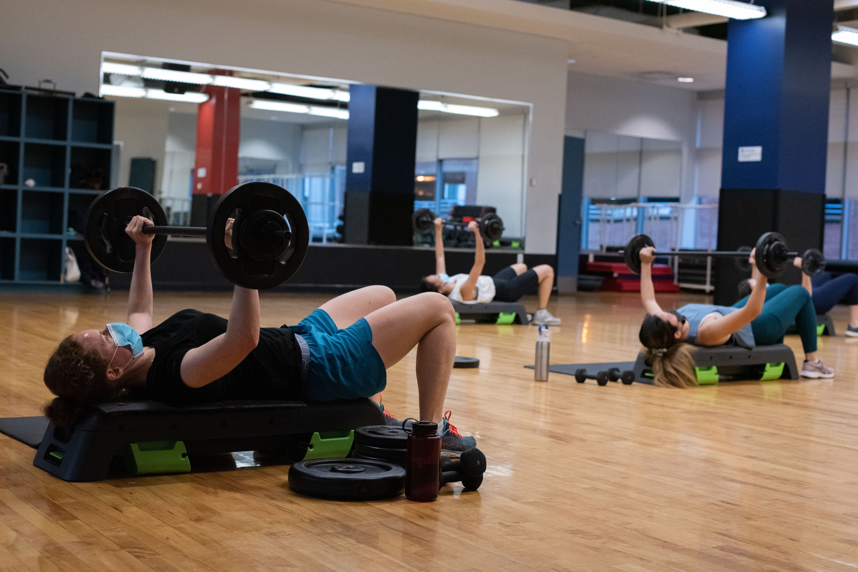
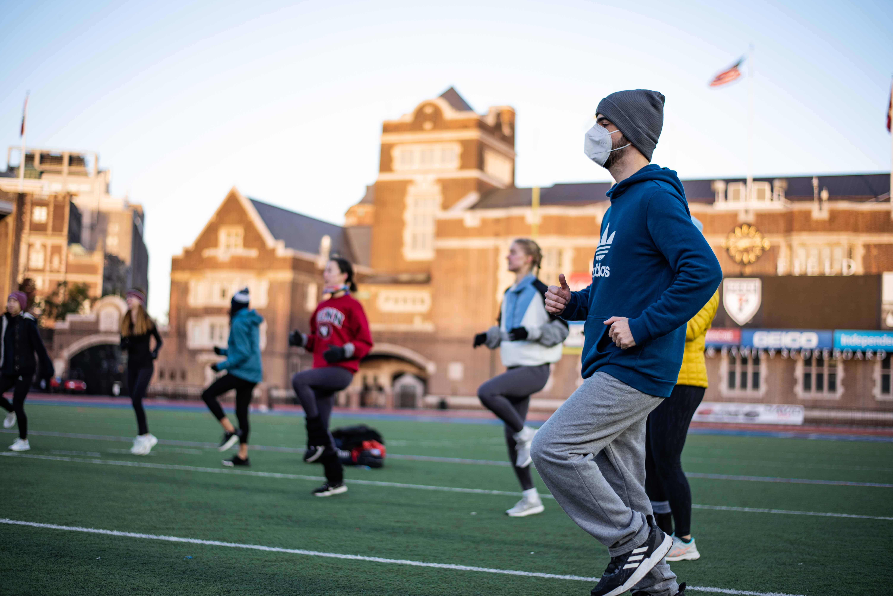
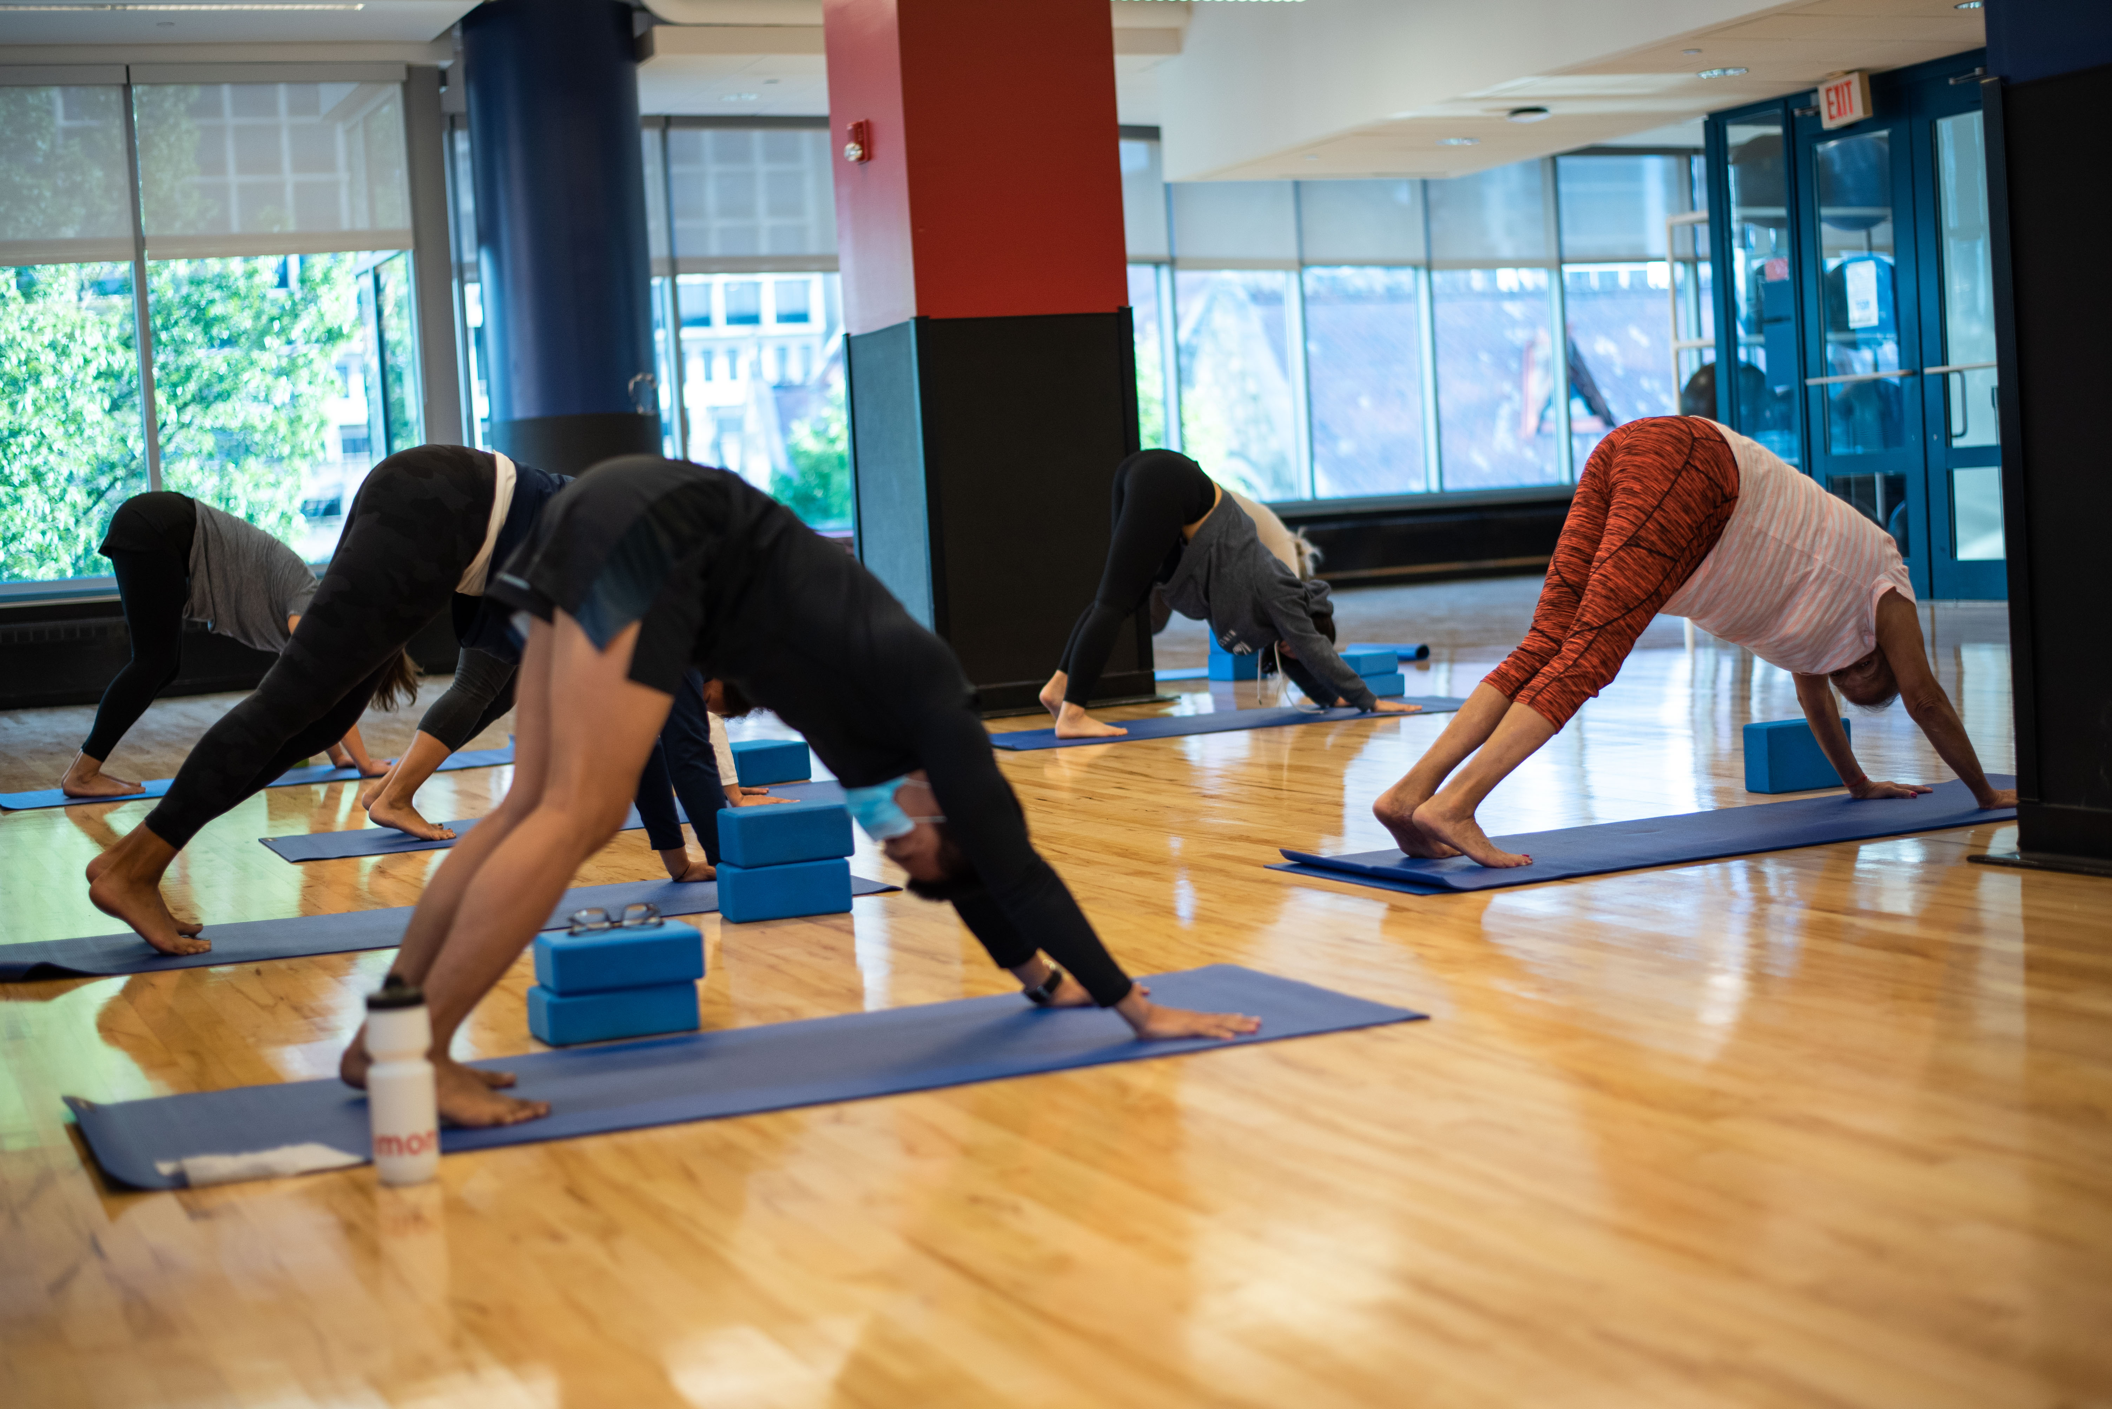
FITNESS & WELLNESS
  Group Exercise
    Free group exercise classes included with membership: Zumba, Yoga, Mat Pilates, Dive-in workouts, etc.
    Group Ex Plus classes: Circuit, Full-Body Strength, Cardio Kickboxing, Spinning, etc.
  Personal Training
    30 & 60 min – 5, 10, & 15 session packages
    Small Group Training
    Body composition testing & Fitness Assessments
  Premium Fitness
    Reformer Pilates
    Weightlifting 101, Weightlifting Advanced, & Weightlifting for Women
  Pilates
    60 min – 3, 5, & 10 session packages
    Private & Semi-Private sessions
  Wellness Outreach
    Customized fitness & wellness programs (e.g. private group exercise, workshops, etc.)

Slide 5
AQUATICS & ADVENTURE
  Aquatics
    Recreational swim
    Private swim lessons
      30 min – 4 or 8 session packages
    Semi-Private swim
      45 min – 4 or 8 session packages
    Group swim
      4 youth levels, 2 parent-child levels, & 2 adult levels
      30 min – parent-child levels, youth levels
      45 min – adult levels
    Certification Courses
      SCUBA through PADI
      Lifeguard certification through American Red Cross
  Adventure
    Climbing wall
      Annual, Semester or Daily Memberships available
      Climbing equipment & belay service provided
      Top-rope climbing & bouldering offered
    Outdoor equipment rentals
      Camping gear (tents, sleeping bags, cooking supplies, etc.)
      Hiking backpacks
      Climbing gear (helmets, crash pads)

Slide 6
STRUCTURED SPORT
  Sport Clubs
    34 student-led teams
      Self-funded through membership dues
      Basketball, ice hockey, rugby, soccer, sailing, equestrian, & more!
    ~1000 student athletes
    Nationally ranked & competitive teams
    Social & athletic opportunities
    Employment & leadership opportunities
    Team membership varies – available to undergraduate & graduate students
Intramurals
  12+ leagues and tournaments
  Vary in length from 1 day to multi-week
  Soccer, basketball, volleyball, softball, flag football, & more
  Competitive and recreational leagues available
  Flexible scheduling options
  Competitions held at Pottruck, Penn Park, Tse Center, Franklin Field
  Social & athletic opportunities
  Employment opportunities

Slide 7
SPECIAL EVENTS
  Annual
    Penn TRI
    Homecoming Hustle
    Alumni Warm-up
    NSO Welcome & Open House
    Penn Relays 5k
    Wellness Week
  Monthly First Fridays
  Demo weeks
  Pop-up events
    Pride celebration workouts
    Yoga in the Palestra
    Franklin Field Yoga & Bootcamp

Slide 8
CAMPUS REC FACILITIES
  Pottruck Health & Fitness Center
    4 floors of cardio & strength equipment
    Sheerr Pool & sauna access
    Group Exercise studios: Pilates, Personal Training, Spinning, Yoga
    Golf Simulator
    Climbing Wall
    Basketball Courts
    Locker rooms: day-use and rental locker availability, shower facilities (no towels included)
    Sweet Treat Hut – smoothie & snack bar
  Fox Fitness
    2 floors of cardio & strength equipment
    TRX, functional workout space, power racks, day-use lockers
    Access to Franklin Field outdoor track during recreational hours (M-F 11:00am-2:00pm)

Slide 9
PENN TRADITIONS
  Franklin Field
    127 year old historic football stadium
    Homecoming vs. Yale 10/22
  Palestra
    95 year-old historic basketball stadium
    Big 5 (Penn, St. Joes, LaSalle, Villanova, Temple)
    City 6 (Penn, Drexel, St. Joes, LaSalle, Villanova, Temple)
  Penn Relays Carnival
    Oldest and largest track & field meet in the US
  Spring Fling
  Wharton Fight Night

Slide 10
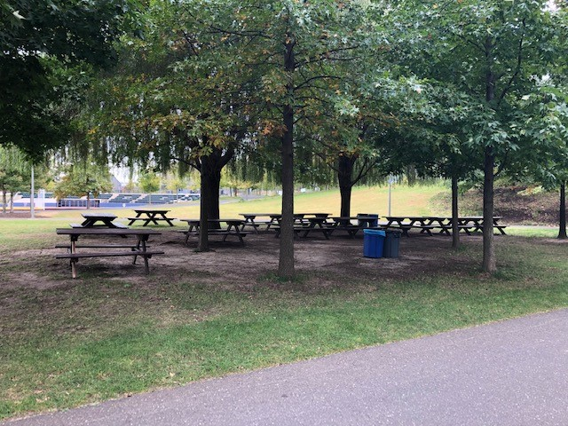
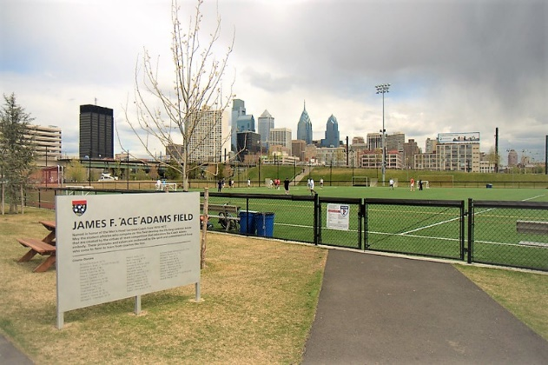
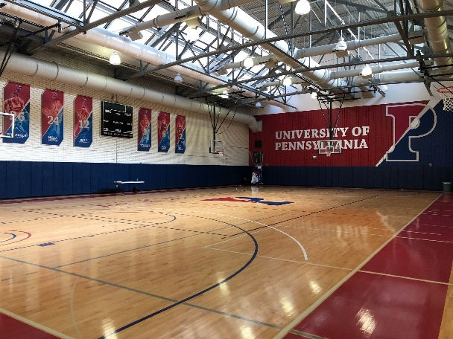
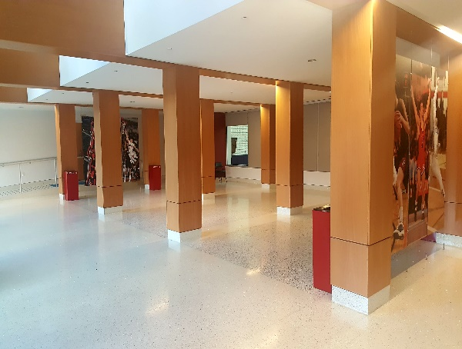
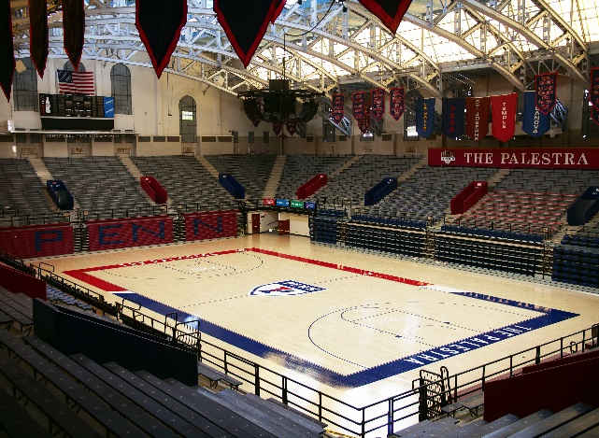

BUSINESS DEVELOPMENT
  If interested in renting athletic space in Penn Park or Pottruck, fill out this formsite link:
    https://fs28.formsite.com/GoPennAthletics/form24/index.html?1550014655919
    Once formsite is filled out, a member of the Business Development department will be in touch within 3-5 business days
    Event request must be submitted 2 weeks prior to event date
  Rental Rates
    Student Group Rate: $75 an hour
    All Student Groups must be registered through VPUL
    Penn Athletics Special Events

Slide 11
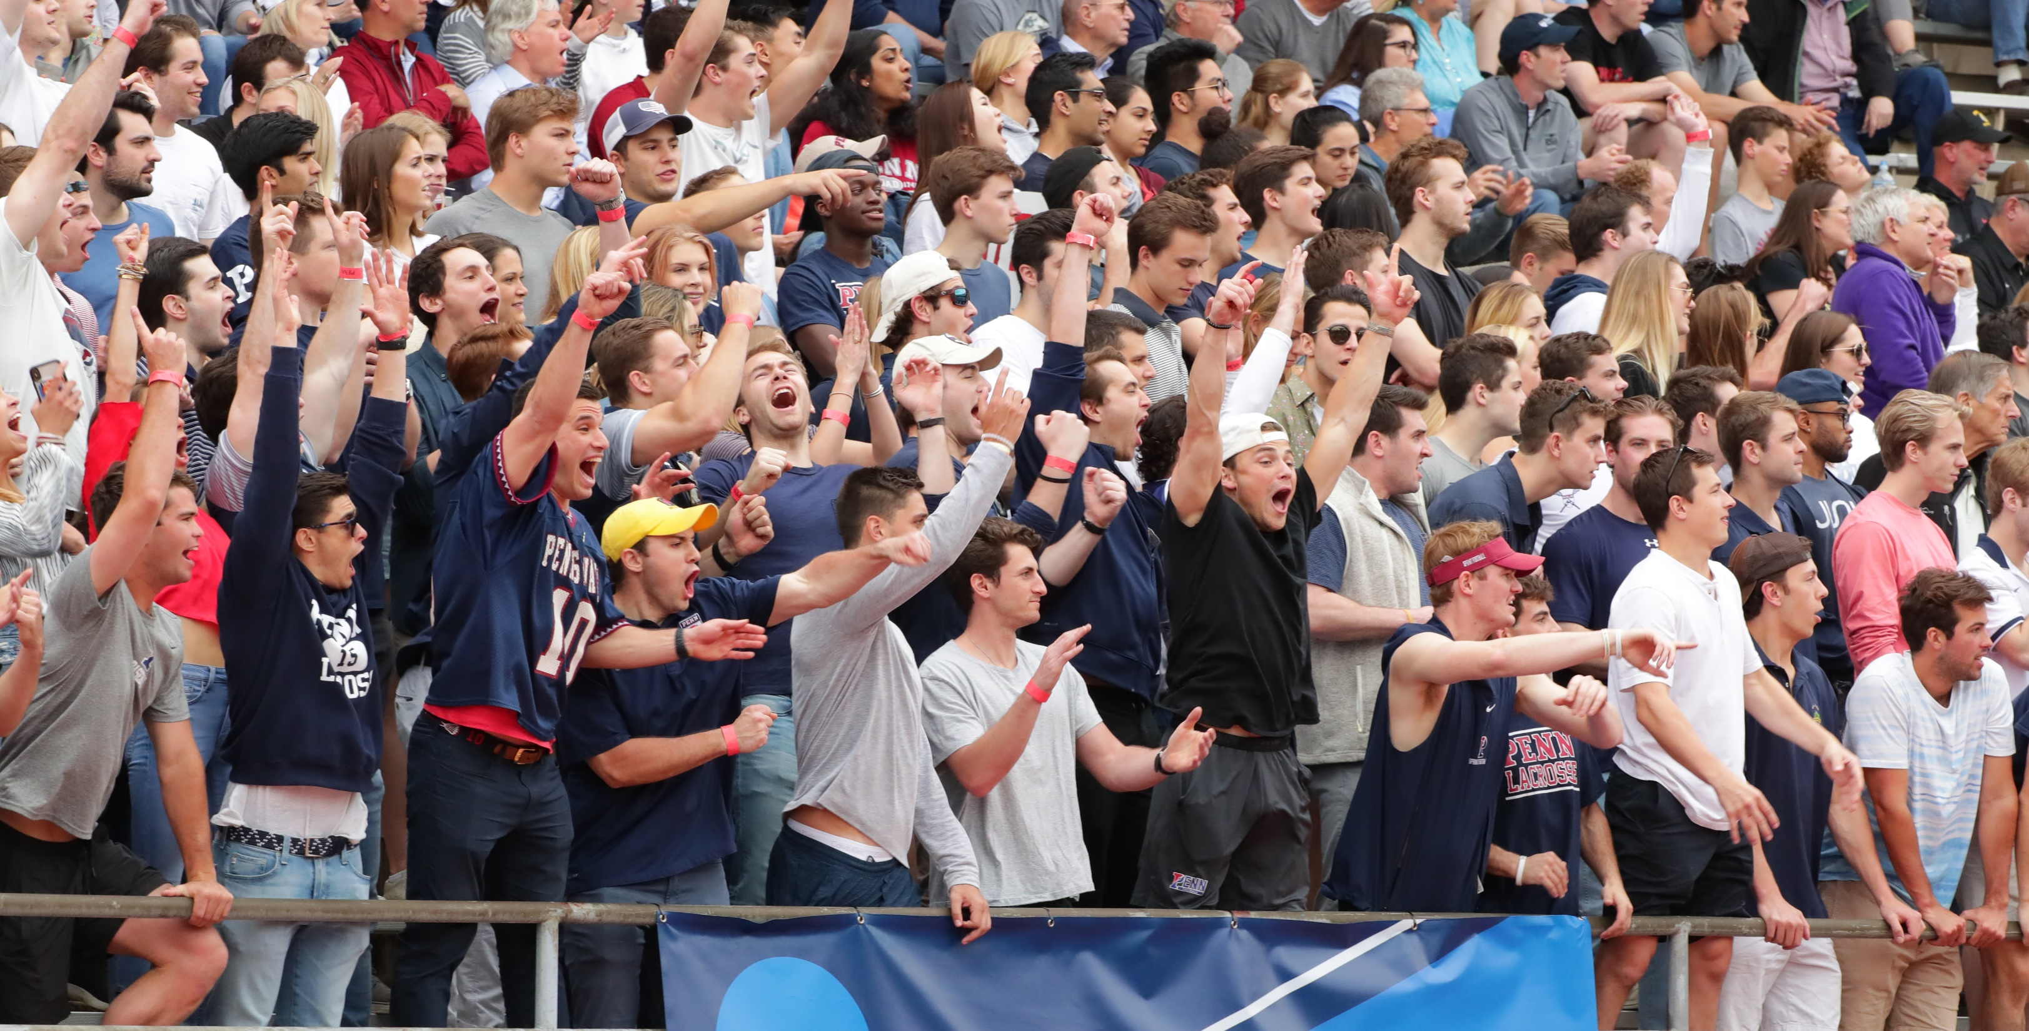

#QUAKEREVERYDAY

